Slide 1
DSS presentation - Influence of Bad Apples?
Vinit Todai, Shreyas Lele, Tejul Pandit

Slide 2
Background and theme
We aim to analyze and evaluate the relationship between the various available features of police officers to assess if they have a significant impact on the trends observed on sustained allegations.
We have tried to realise whether there is a dependency on race or rank of police officer affecting the decision of allegation being sustained
This could potentially help to identify if groups of officers who have similar features also follow similar trends in terms of allegations they receive.
Analyze the influence of ranks and police units amongst officers with maximum allegations.
Identify and provide more insight to the allegations raised against police officers.

Slide 3
Checkpoint 1: Relational Analytics
And
Checkpoint 2: Visualization

Slide 4
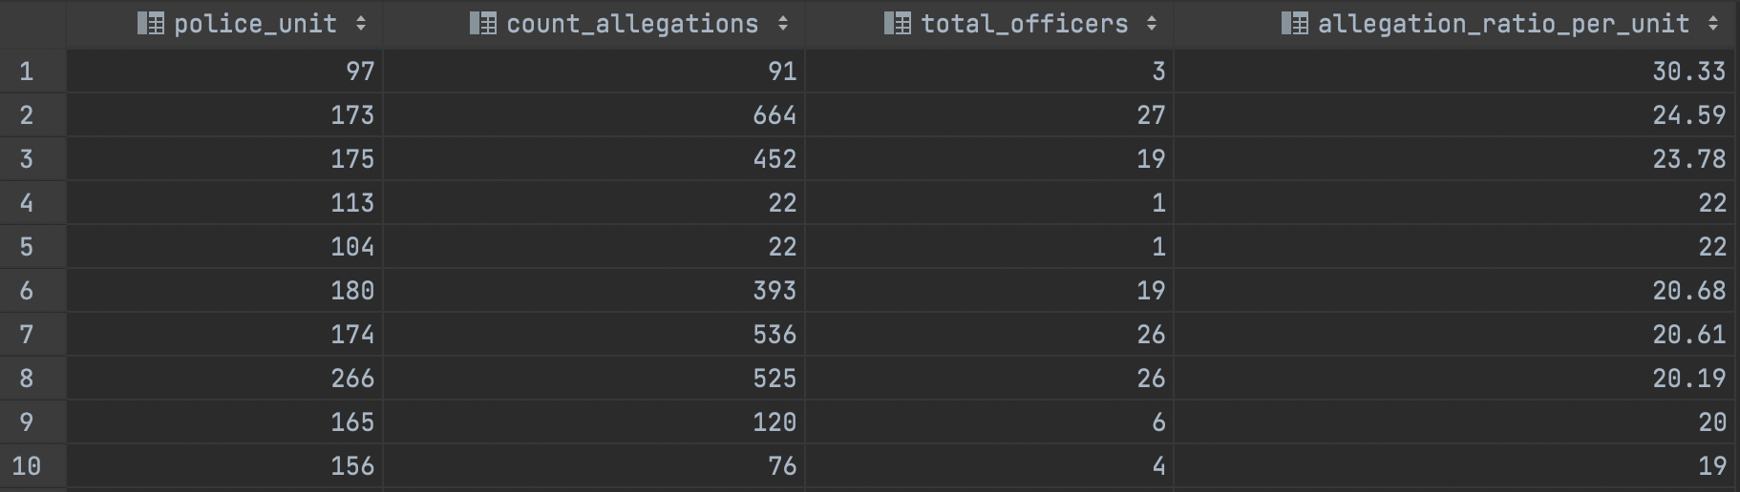
What is the average per-officer-allegation-count in a police unit?
There are around 10 police units with an average allegation per officer in the range of 20-30

Slide 5
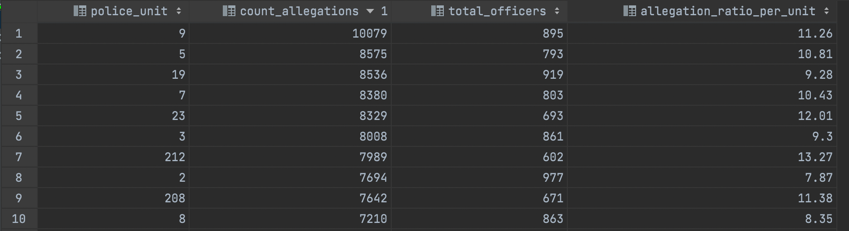
What is the average per-officer-allegation-count in a police unit?
Top 10 police units with maximum allegations have and average of 7-14 allegations per officer

Slide 6
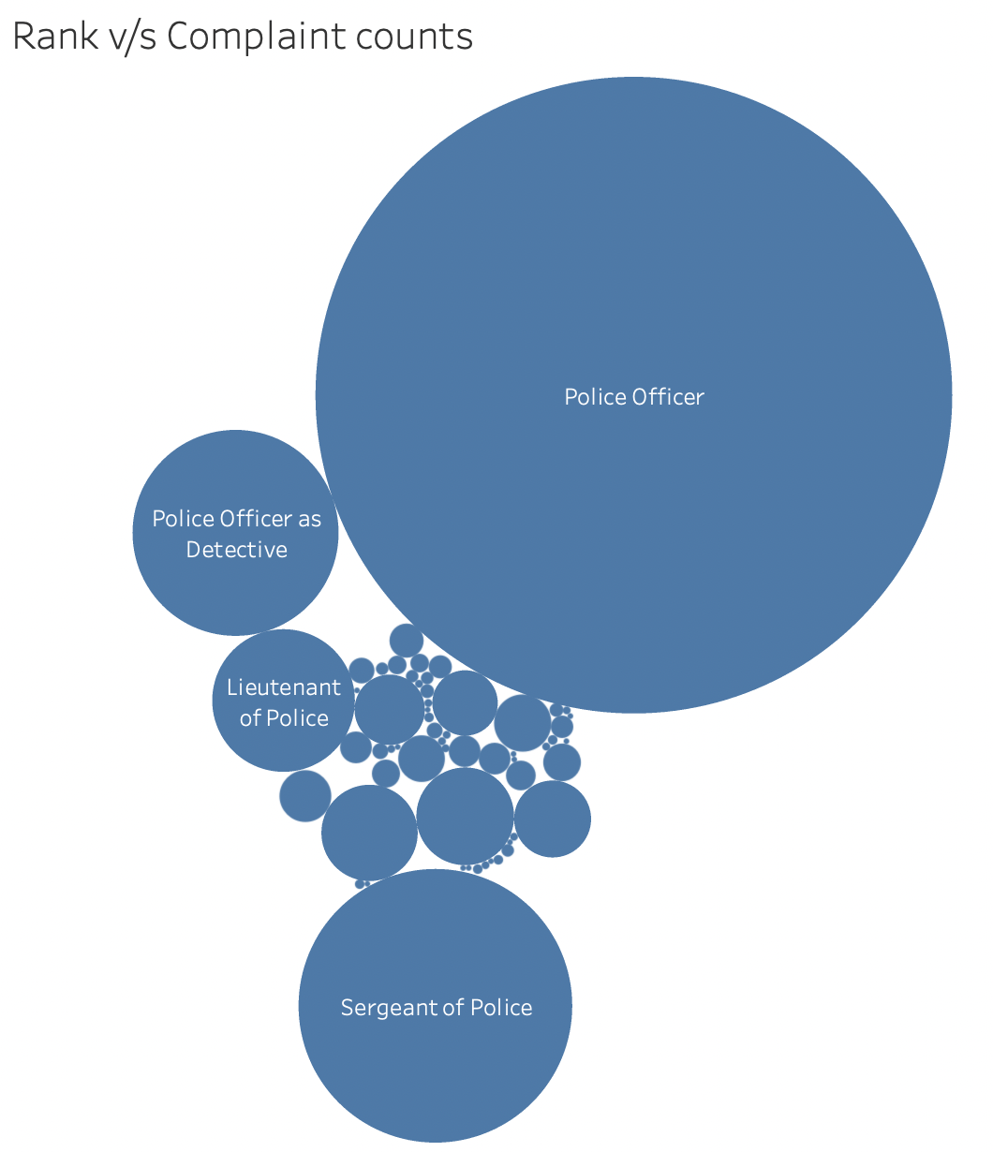
Are complaints against junior police officers sustained more often as compared to senior police officers?
i.e. do senior officers take advantage of their positions to get the allegations levied against them to be dropped?

Slide 7
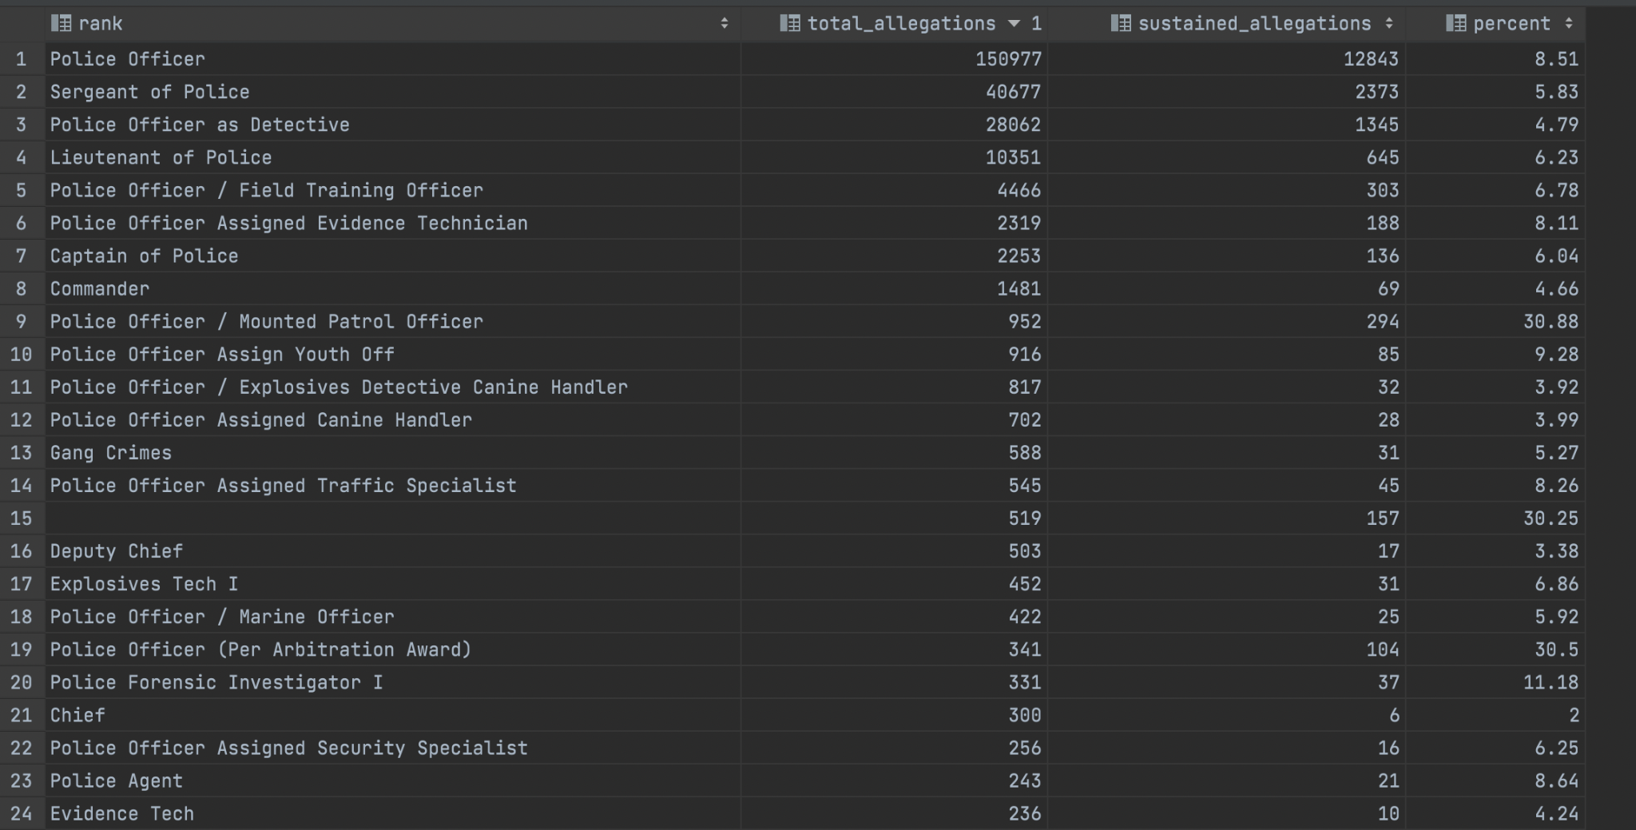
Are complaints against junior police officers sustained more often as compared to senior police officers?

Slide 8
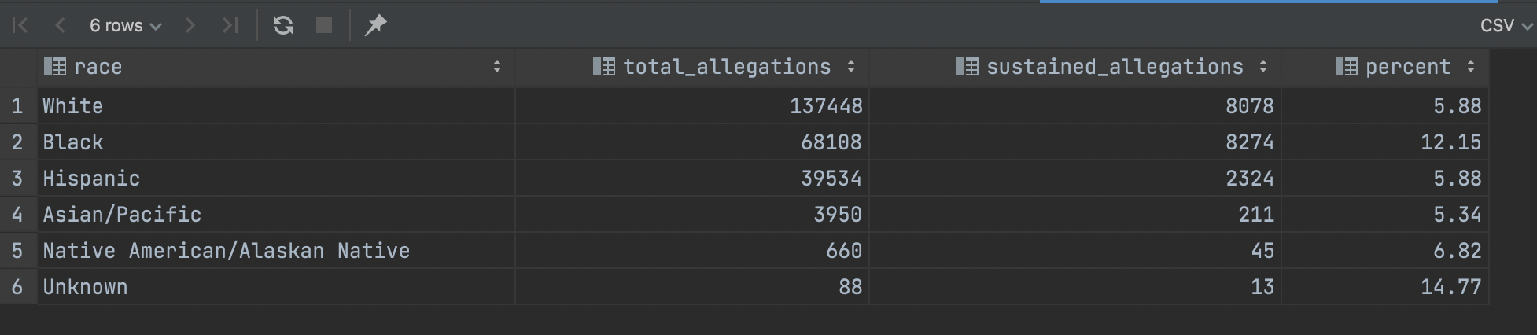
What is the relation between the race of the police officers and the number of complaints against him/her and number of complaints sustained?

Slide 9
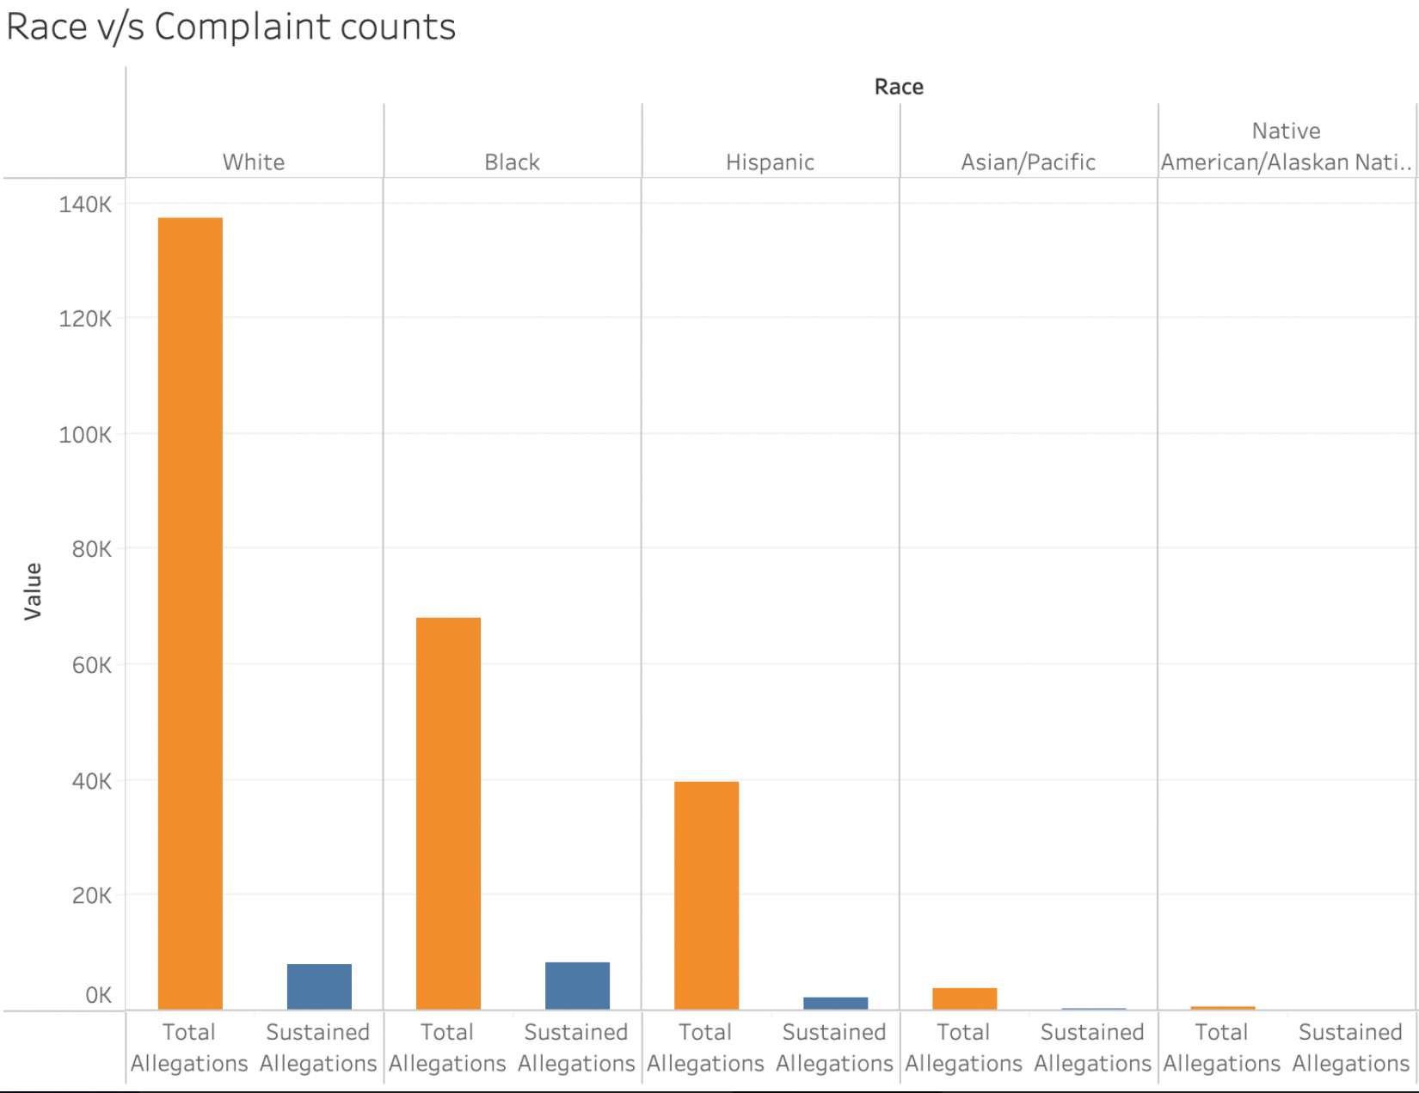
Thus it is seen that for White Officers the ratio of sustained count to allegation count is very less.
It is, however, double for Black Officers. Thus it is possible that the race of a police officer might
be a factor that plays a role on whether an allegation against an officer will be sustained or not.

Slide 10
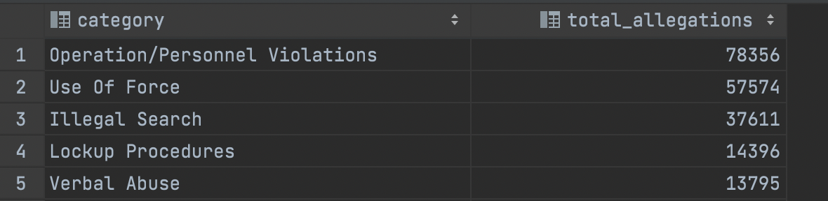
What is the maximum occurring category for the allegations against each police officer?

Slide 11
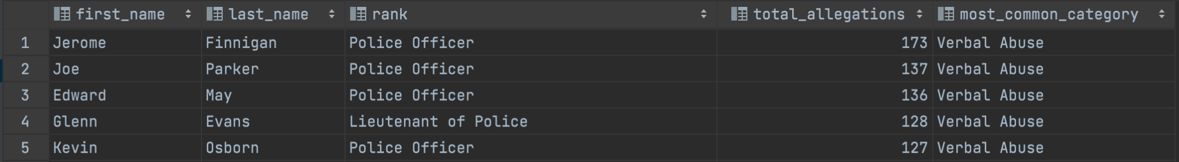
What is the maximum occurring category for the allegations against each police officer?
We identified that most of the allegations belonged to a single category for every officer.

Slide 12
Checkpoint 3: Interactive Visualization
Identifying the distribution of allegations in a particular police unit with time.
https://observablehq.com/@5b0e7a483d797e6e/bar-chart-race

Slide 13
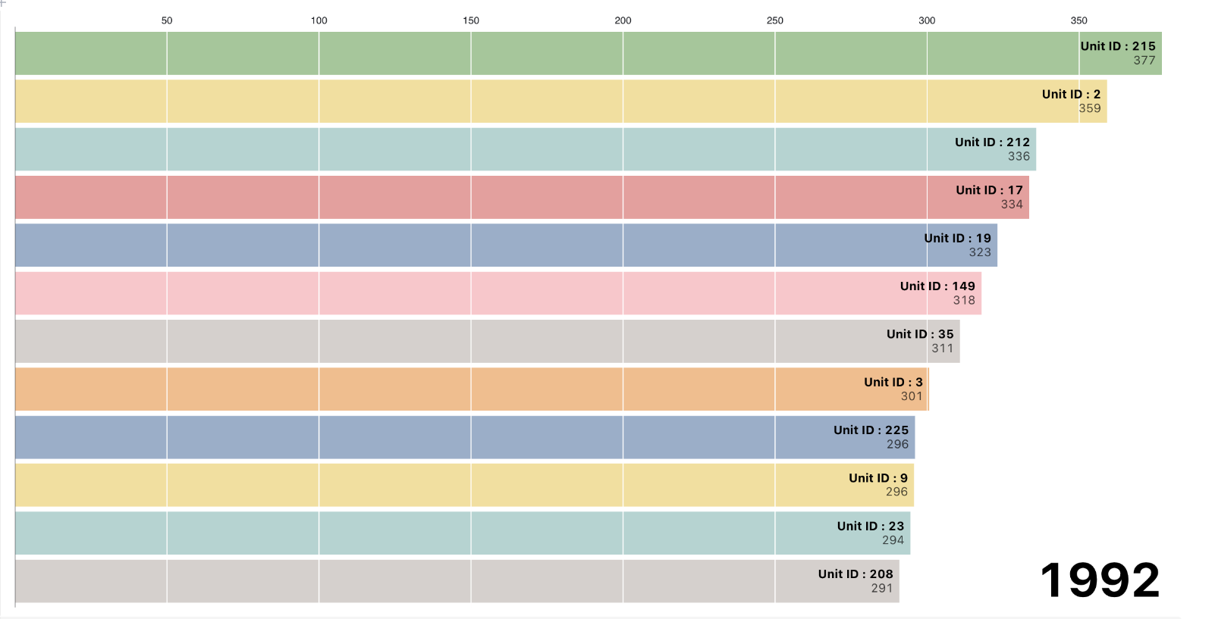
Checkpoint 3: Interactive Visualization
Identifying the distribution of allegations in a particular police unit with time.

Slide 14
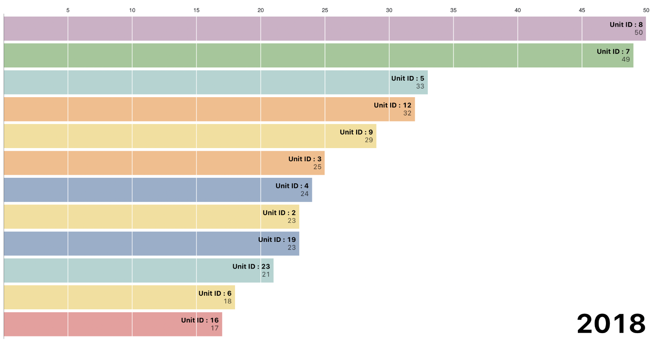
Checkpoint 3: Interactive Visualization
Identifying the distribution of allegations in a particular police unit with time.

Slide 15
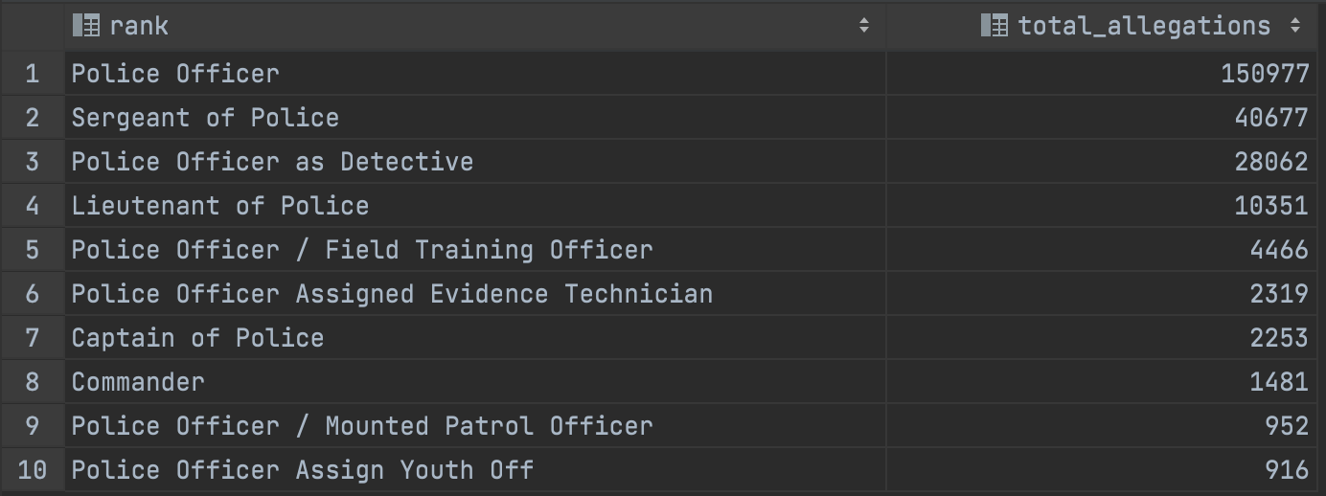
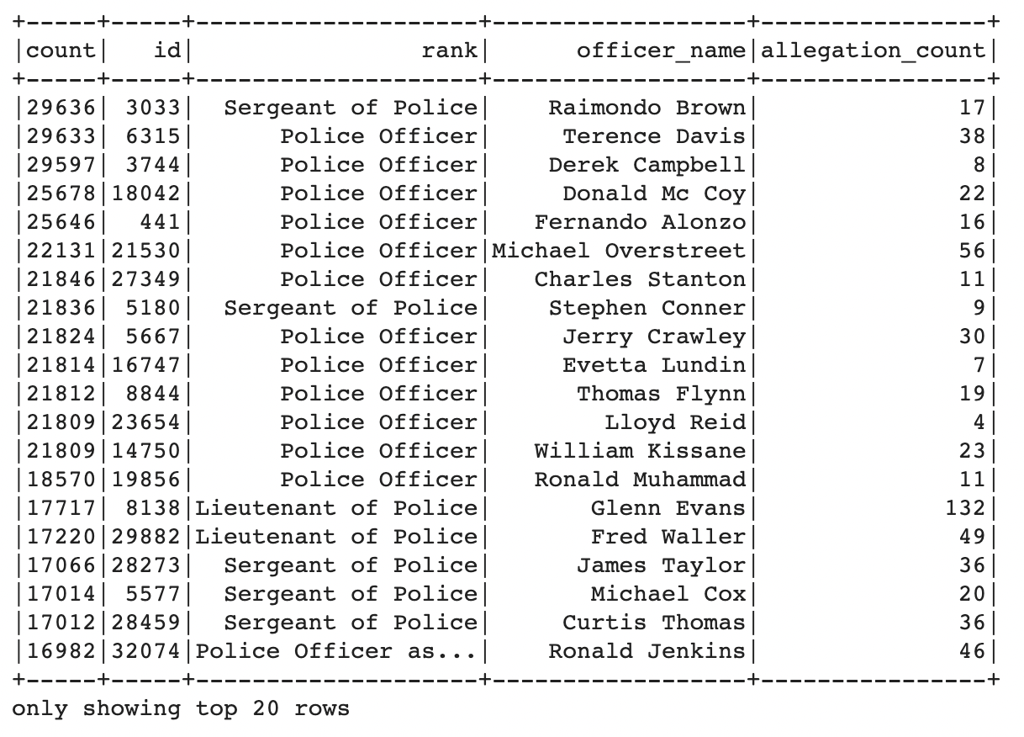
Checkpoint 4: Graph Analytics
Amongst officers who belong to a rank that is in the top 10 ranks with the maximum allegation counts, what is the frequency of two officers being co-accused on the same allegation?

Slide 16
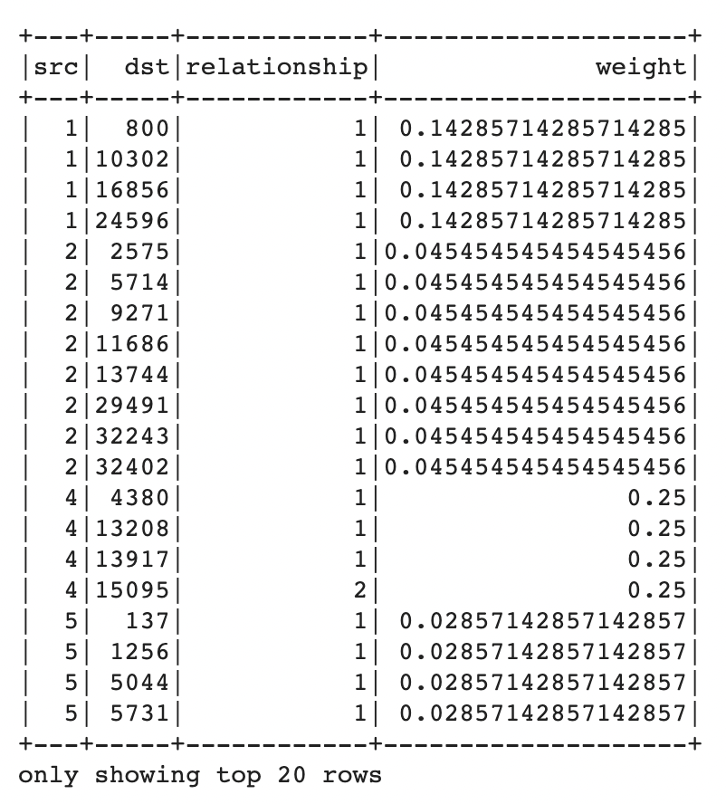
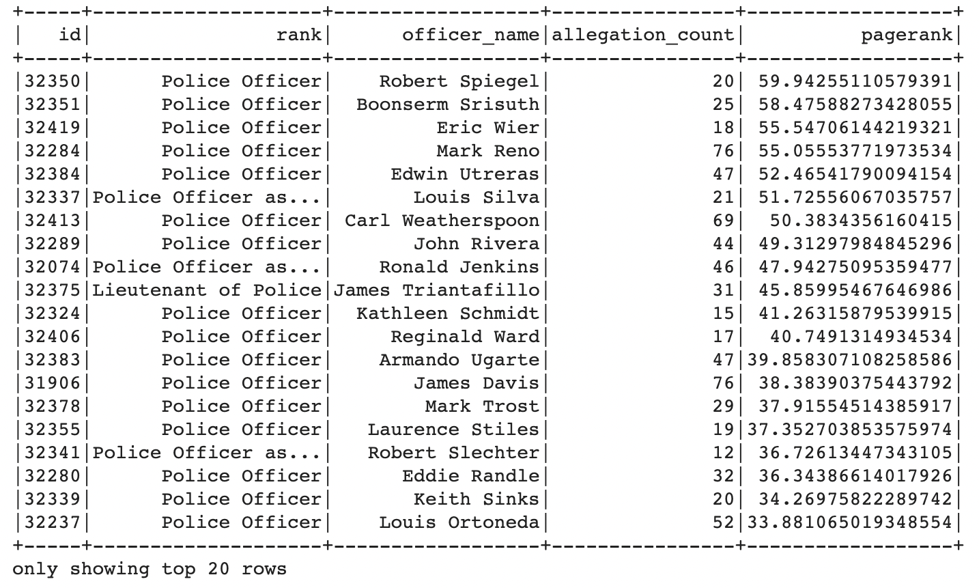
Checkpoint 4: Graph Analytics
Amongst officers who belong to a rank that is in the top 10 ranks with the maximum allegation counts, what is the frequency of two officers being co-accused on the same allegation?

Slide 17
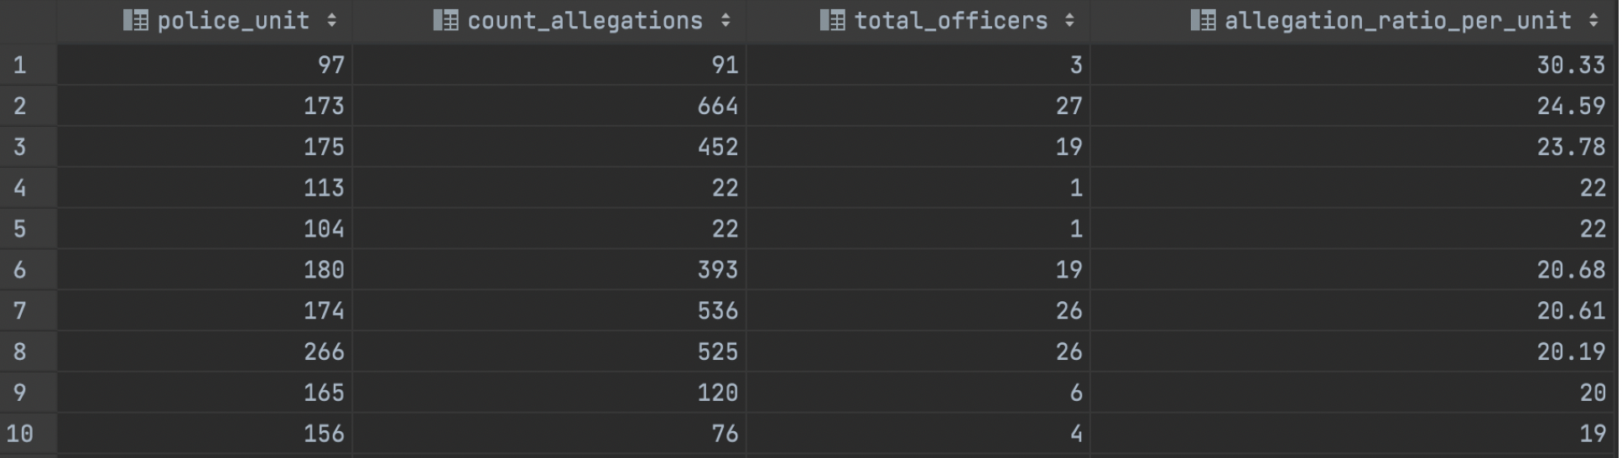
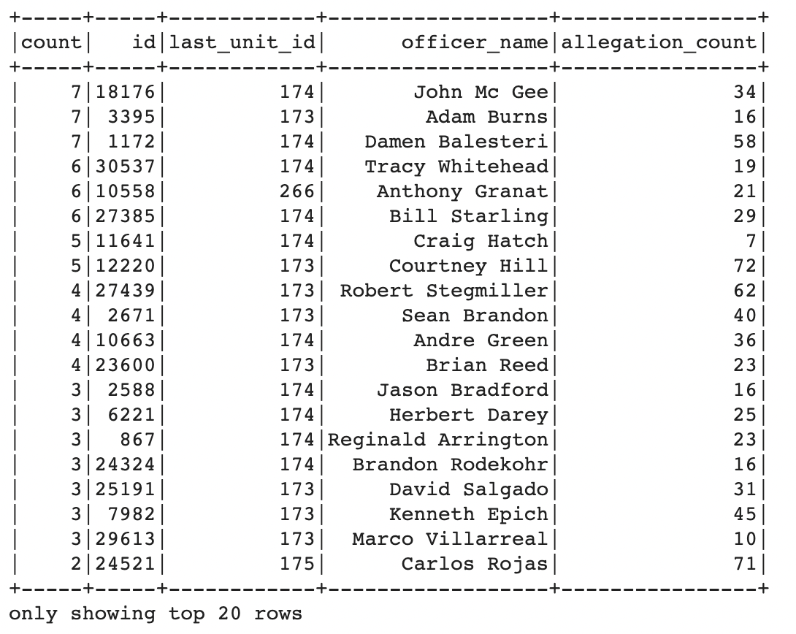
Checkpoint 4: Graph Analytics
Amongst officers who belong to a police unit that is in the top 10 ranks with the maximum allegation ratio per officer, what is the frequency of two officers being co-accused on the same allegation?

Slide 18
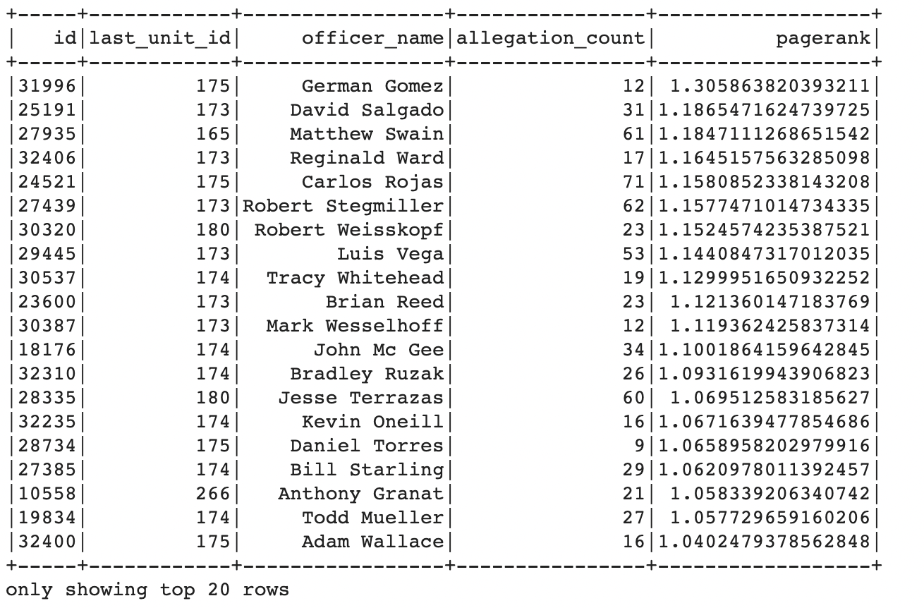
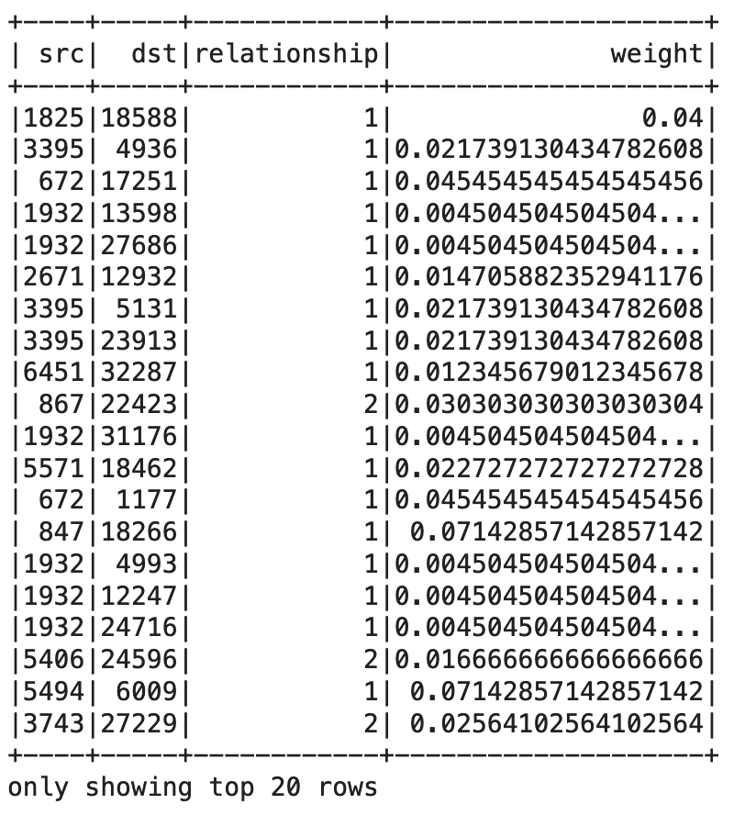
Checkpoint 4: Graph Analytics
Amongst officers who belong to a police unit that is in the top 10 ranks with the maximum allegation ratio per officer, what is the frequency of two officers being co-accused on the same allegation?

Slide 19
Checkpoint 5: Natural Language Processing
Amongst officers who belong to a rank that is in the top 10 ranks with the maximum allegation counts, what are the different topics that can be modelled on the allegation text?
We filtered the officer data based on the ranks and count of allegations; the corresponding allegation text against the officers identified is used to assess the different topics of allegations covered.
The text consisting of allegations against the police officers is present in the cr_text column in data_allegation table.

Slide 20
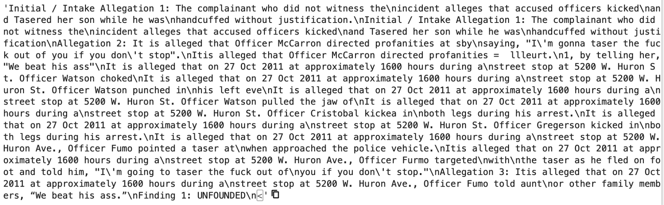
Sample Raw Text from ‘cr_text’ column in data_allegation

Slide 21
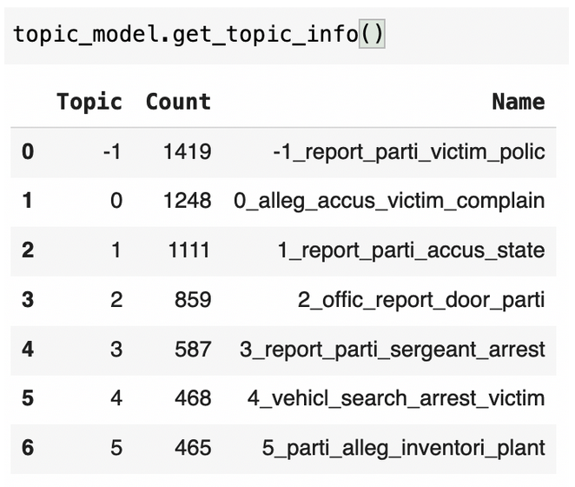
Pre-processed text used as input in topic model
Bertopic model output to get 6 broad classes

Slide 22
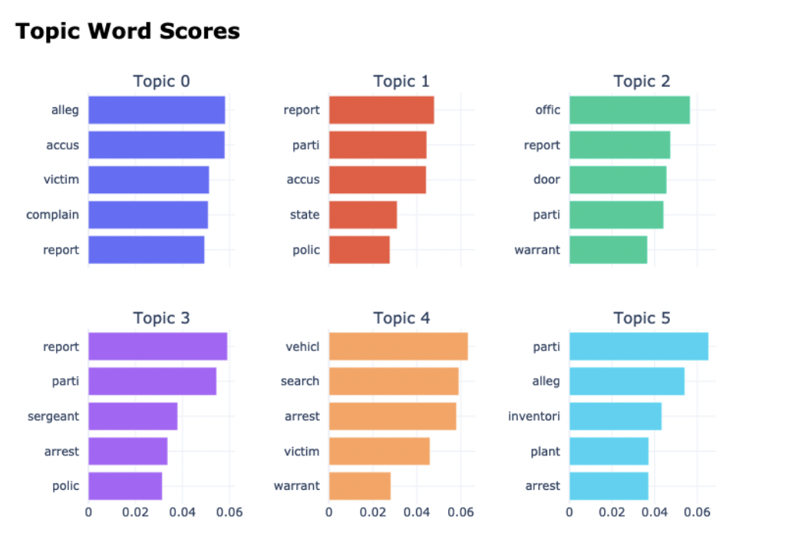
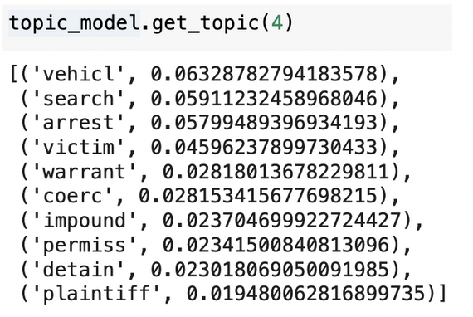
Topic wise bar-chart visualization
Analysis of topic 4 of the model

Slide 23
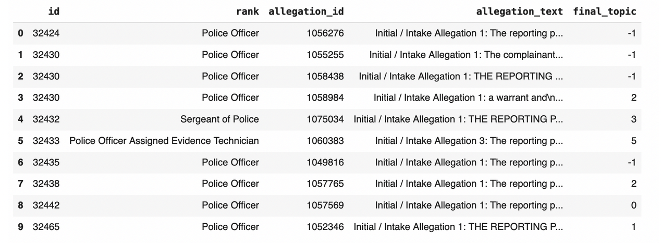
Using the topic model on unseen data to assign each allegation with a topic cluster

Slide 24
To Conclude…
We can conclude that the race and rank of a police officer may be playing a role in determining if an allegation is sustained or not.
There is a strong influence of certain police officers over other police officers.
The topic models created, provide further insight in the allegation category assigned to each allegation.

